Slide 1
EE542 - Reading Assignment – 07 Memory or Time: Performance Evaluation for Iterative Operation on Hadoop and Spark
Presenter: Boyang Xiao
USC id: 3326-7302-74
Email: boyangxi@usc.edu

Slide 2
Index
Introductions and background
System overview
Experiment environment
Experiment implementations
Experiment results
Q&A

Slide 3
Introductions and background
Hadoop introductions and suspicions
Hadoop is a very popular general purpose framework for many different classes of data-intensive application, which provides an open source implementation of MapReduce
Hadoop is not good for iterative operations because of the cost paid for the data reloading from disk at each iteration
Spark introductions and suspicions
Spark, which is designed to have a global cache mechanism, can achieve better performance in response time since the in-memory access over the distributed machines of cluster will proceed during the entire iterative process
Although Spark can achieve tremendous speedup, it is suspected that it requires high memory cost for the introduction of RDDs

Slide 4
System overview
System overview for Hadoop
Hadoop is composed of two layers
HDFS : a data storage layer called Hadoop distributed file system
MapReduce: a data processing layer called Hadoop MapReduce Framework
HDFS is a block-structured file system managed by a single master node. A processing job in Hadoop is broken down to as many Map tasks as input data blocks and one or more Reduce tasks. An iterative algorithm can be expressed as multiple Hadoop MapReduce jobs.
System overview for Spark
Spark is a novel cluster computing framework that is designed to overcome Hadoop’s shortages in iterative operations
Spark uses Hadoop supported storage systems (e.g. HDFS) as its input source and output destination
Spark introduces a data structure called resilient distributed datasets (RDDs) to cache data

Slide 5
Experiment environment
Experiment settings
Cluster size: 8 computers
OS: Ubuntu 12.04.2 (GNU/Linux 3.5.0-28-generic x86 64)
Network switch: H3C S5100 w/ port rate 100Mbps
Cluster manager: Apache Mesos 0.9.0
Hadoop ver. 0.20.205.0
Spark ver. 0.6.1
Experimental data
five real graph datasets
five generated synthetic graph datasets to do comparative experiments

Slide 6
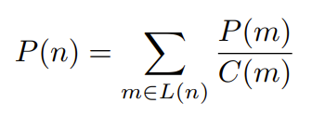
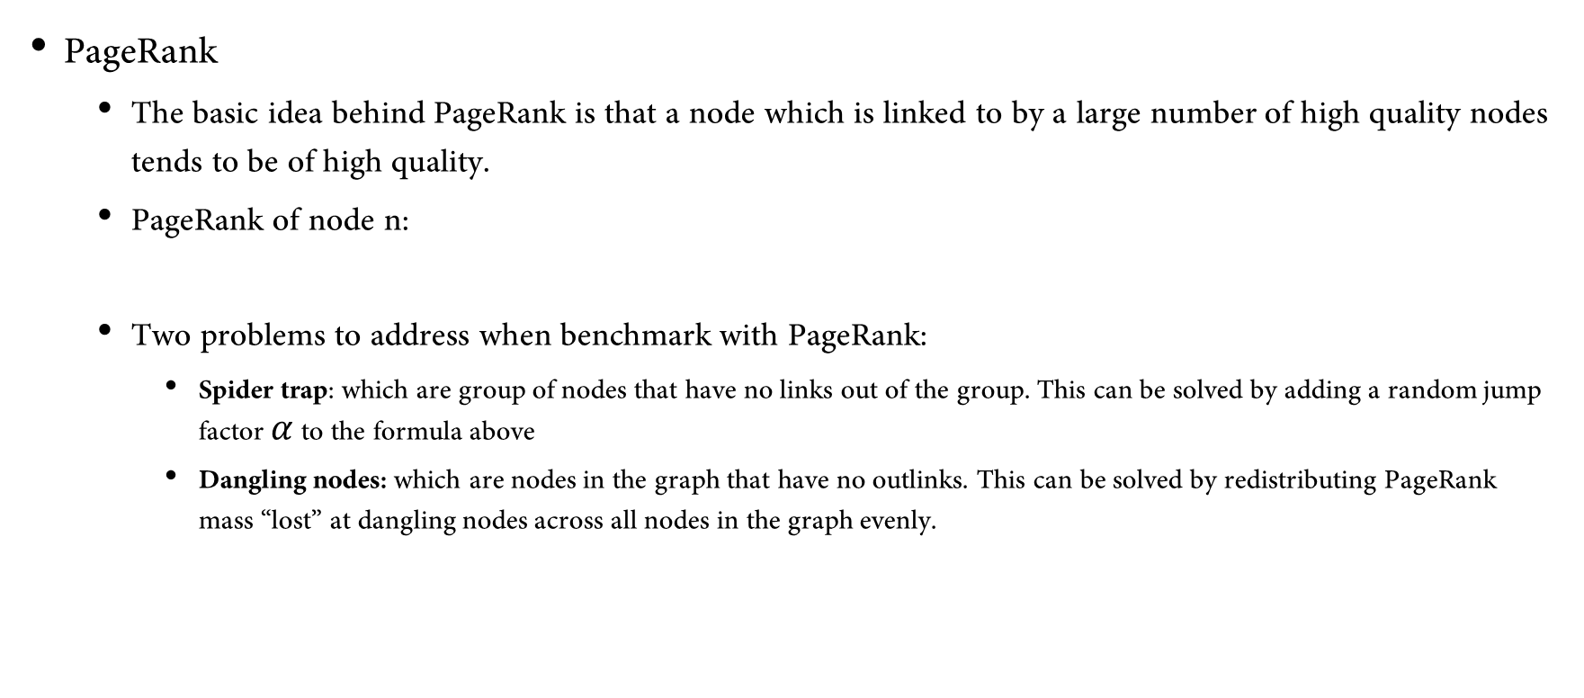
Experiment implementations
PageRank
The basic idea behind PageRank is that a node which is linked to by a large number of high quality nodes tends to be of high quality.
PageRank of node n:
Two problems to address when benchmark with PageRank:
Spider trap: which are group of nodes that have no links out of the group. This can be solved by adding a random jump factor $α$ to the formula above
Dangling nodes: which are nodes in the graph that have no outlinks. This can be solved by redistributing PageRank mass “lost” at dangling nodes across all nodes in the graph evenly.

Slide 7

Experiment implementations
PageRank on Hadoop
The basic process of each PageRank iteration can be divided into two Hadoop MapReduce jobs.
In the first job, each node m first divides its current PageRank value P(m) evenly by C(m), the number of nodes m links to and passes each share to them separately.
Before the second job, the total PageRank loss l at dangling nodes needs to be calculated.
In the second job, each node n updates its current PageRank value P(n) to P(n) according to formula below:

Slide 8
Experiment implementations
PageRank on Spark
All the iterative operations can be implemented in a Spark driver. Each iteration includes four steps.
The first step distributes the PageRank value of each node to its neighbors using the join and flatMap transformation.
The second step does PageRank aggregation for each node using reduceByKey transformation.
In the third step, PageRank loss at dangling nodes is computed.
The fourth step deals with PageRank loss distribution and random jump factor

Slide 9
Experiment results
PageRank Scalability
When datasets are smaller than kronecker22, the PageRank implementations exhibit near-linear scalability on both Hadoop and Spark whether the graphs are real or synthetic
When datasets are larger than kronecker22, slope of Spark line is greater than that of Hadoop line which means that the performance advantage of Spark becomes smaller as the graph size increases
Running Time Comparison
When dataset is too small, Spark can outperform Hadoop by 25x-40x. In this case, the computing resources of all the slaves are underutilized.
When dataset is relatively small, Spark can outperform Hadoop by 10x-15x. In this case, the computing resources of all the slaves are moderately utilized.

Slide 10
Experiment results
Running Time Comparison (cont’d)
When dataset is relatively large, the advantage of Spark becomes small and Spark can only outperform Hadoop by 3x-5x. In this case, for Hadoop the memory of each slave in the cluster is still moderately utilized while for Spark the memory of each slave in the cluster is full which result in Spark’s reduced performance advantage.
When dataset is too large, e.g., kronecker23, Hadoop beats Spark. In this case, for Hadoop, the memory of each slave in the cluster is fully utilized while for Spark the memory of each slave in the cluster is not enough for PageRank running
When dataset is extremely large, e.g., Twitter, PageRank on Spark crashes halfway with JVM heap exceptions while PageRank on Hadoop can still run

Slide 11
Experiment results
Memory Usage Comparison
For Hadoop platform, when dataset is fixed, memory usage exhibits periodically increase and decrease with the increase in the number of iterations. There is also a gradual increment between two consecutive iterations
For Hadoop platform, when iteration number is fixed, the shapes of memory usage plots are similar with the increase in the size of dataset
For Spark platform, when dataset is fixed, memory usage only exhibits periodically gradual increase with the increase in the number of iterations
For Spark platform, when iteration number is fixed, the shapes of memory usage plots are similar with the increase in the size of dataset.

Slide 12
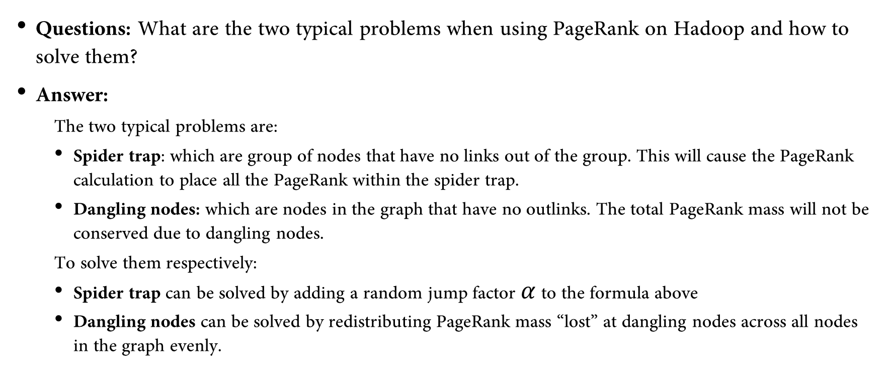
Q&A
Questions: What are the two typical problems when using PageRank on Hadoop and how to solve them?
Answer:
The two typical problems are:
Spider trap: which are group of nodes that have no links out of the group. This will cause the PageRank calculation to place all the PageRank within the spider trap.
Dangling nodes: which are nodes in the graph that have no outlinks. The total PageRank mass will not be conserved due to dangling nodes.
To solve them respectively:
Spider trap can be solved by adding a random jump factor $α$ to the formula above
Dangling nodes can be solved by redistributing PageRank mass “lost” at dangling nodes across all nodes in the graph evenly.

Slide 13
Thanks for watching!
Presenter: Boyang Xiao
USC id: 3326-7302-74
Email: boyangxi@usc.edu

